Slide 1
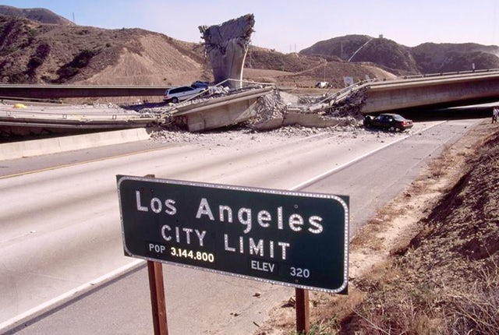
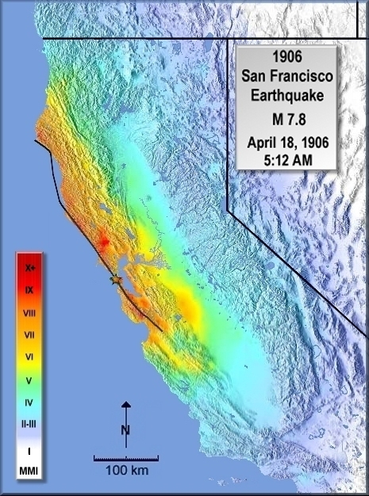
Earthquakes & Mercalli Scale

Slide 2

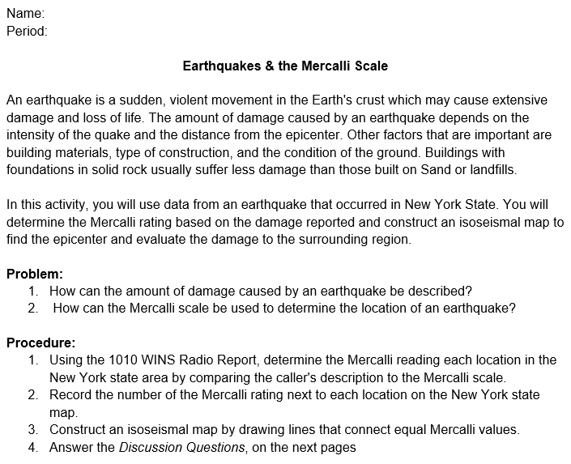
LEARNING TARGET: After 42 minutes, I can use the Mercalli scale to construct an isoseismal map and answer associated questions.

Slide 3
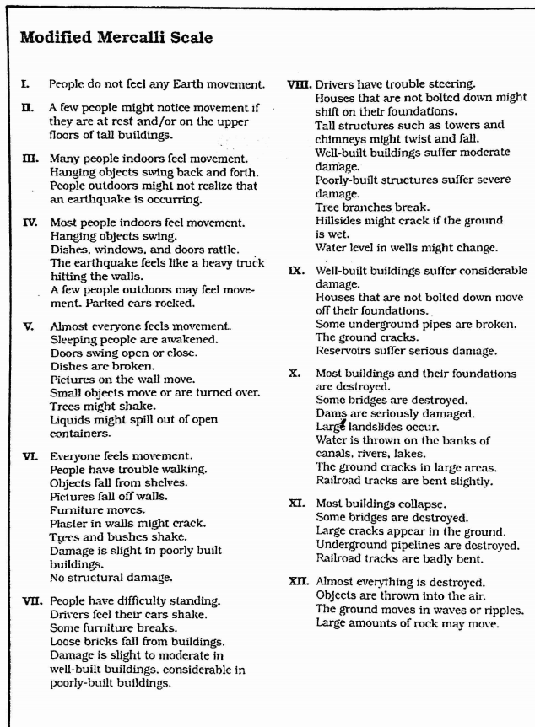
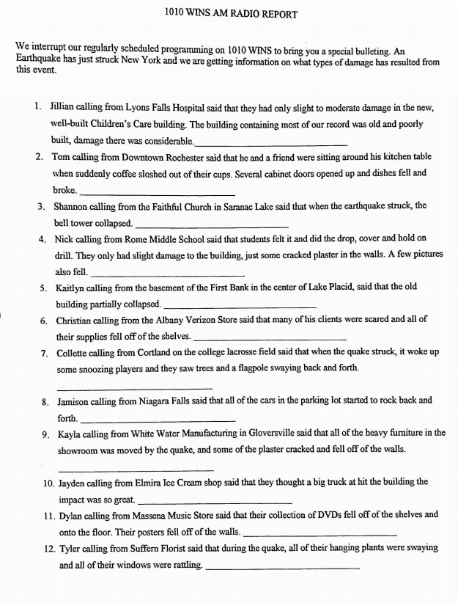

Slide 4
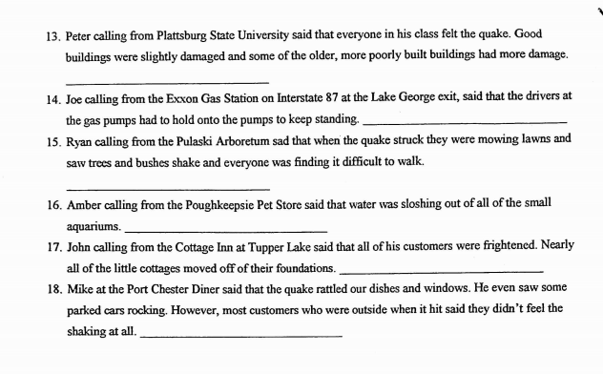
CONTINUED ON BACK

Slide 5
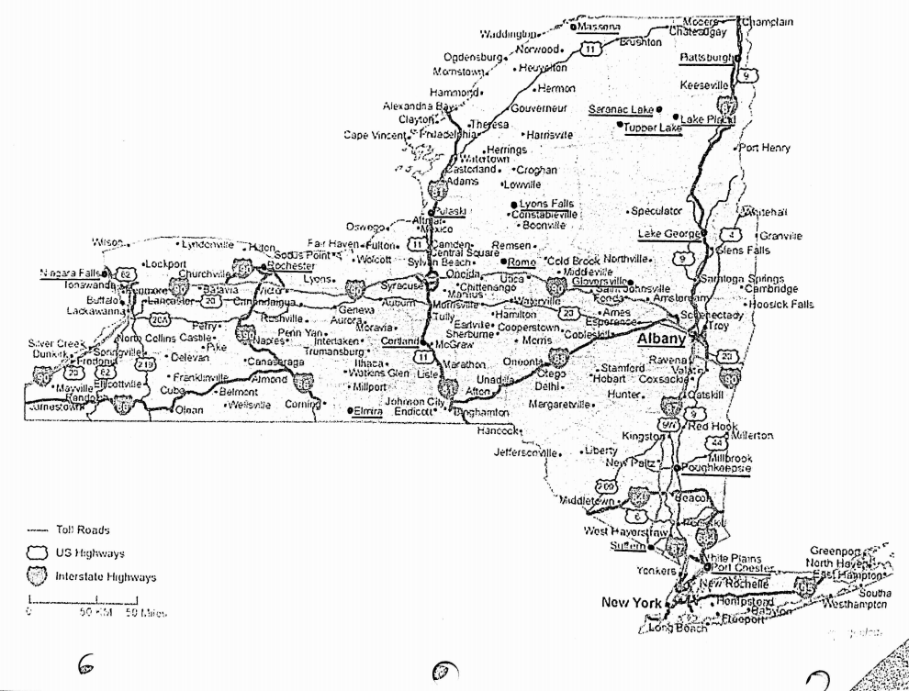

Slide 7
